Slide 1

Cloud-Based File Storage System
Cloud Computing Basic Course - May 2026

Slide 2

Project Overview
Objective: Deploy a self-hosted cloud storage platform with monitoring and performance testing capabilities
Key Components: - Nextcloud: File storage and user management - Docker Compose: Container orchestration - Prometheus + Grafana: Monitoring and visualization - Locust: Load testing and performance analysis
Requirements Addressed: ✓ User authentication & authorization ✓ Private storage spaces ✓ File operations (upload/download/delete) ✓ Scalability, security, and cost-efficiency

Slide 3
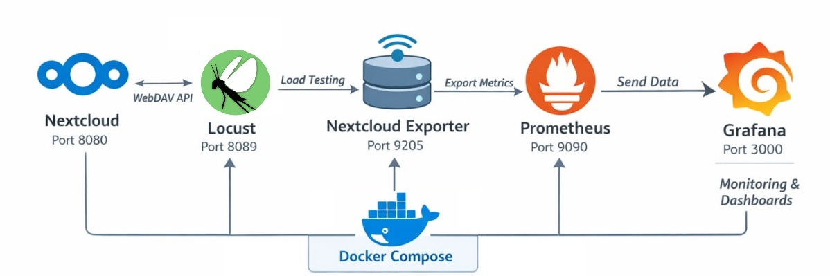
System Architecture

Slide 4
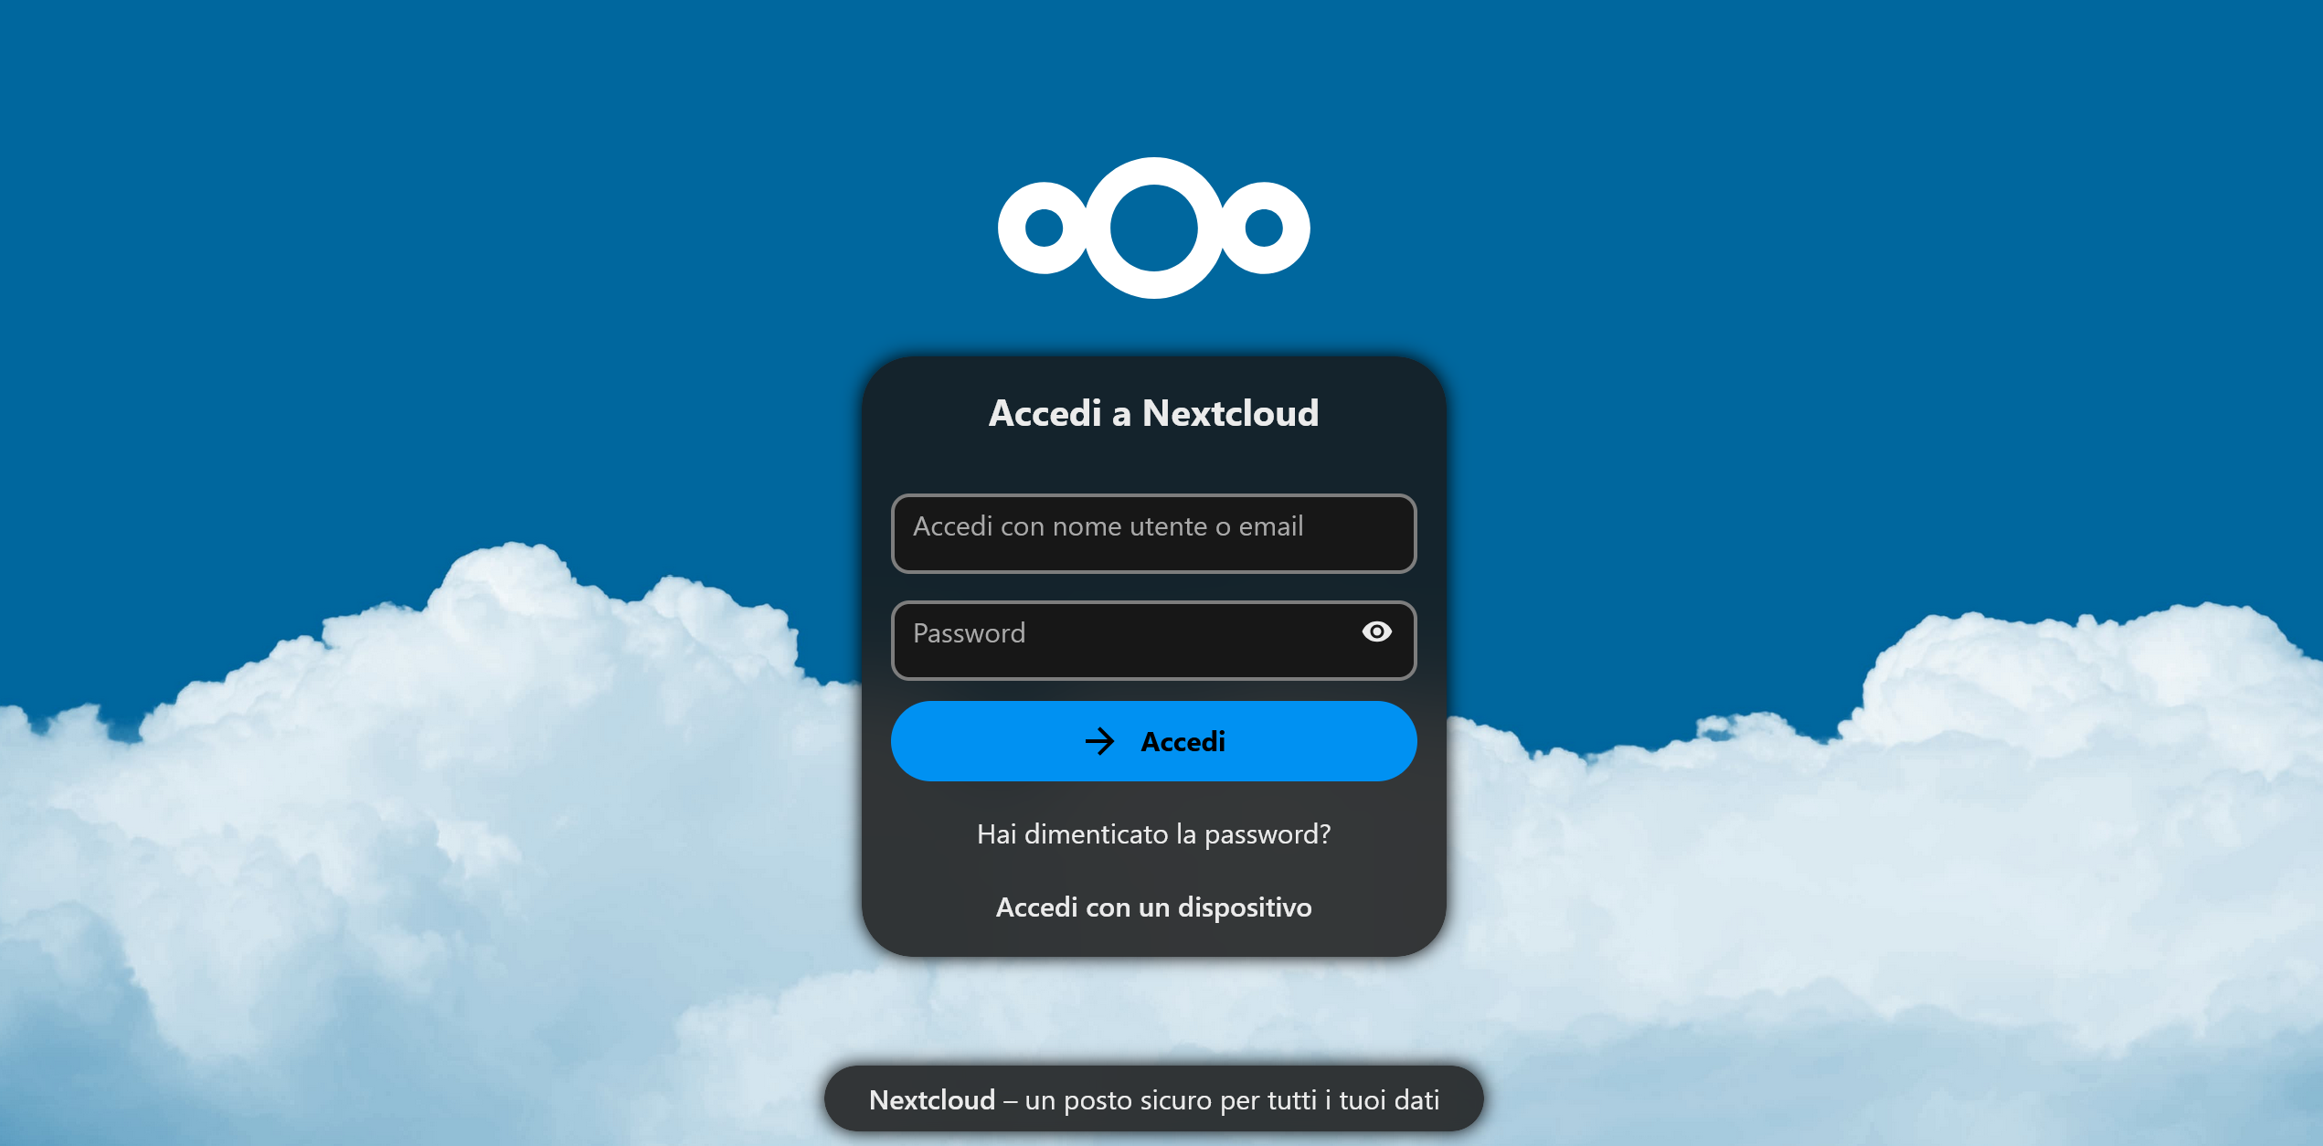
Nextcloud Features
Admin Capabilities: - ✓ User account creation and management - ✓ Private storage allocation per user (`/remote.php/dav/files/username/`) - ✓ Group management and permissions - ✓ System configuration and security settings
User Capabilities: - ✓ Upload/download/delete files - ✓ File preview (images, PDFs, text) - ✓ Folder creation and organization - ✓ Web interface and desktop sync
To log in, hop on http://localhost:8080

Slide 5



Monitoring Stack
Nextcloud Exporter - Scrapes Nextcloud internal metrics - Exposes data at `http://localhost:9205/metrics` - Key metrics: active users, file count, response times
Prometheus - Time-series database - Scrape interval: 15-30 seconds - Configuration: `prometheus/prometheus.yml`
Grafana - Auto-provisioned Prometheus datasource - Custom dashboards for real-time monitoring - Access: `http://localhost:3000`

Slide 6
Load Testing with Locust
**Testing Framework: Locust** **Test Configuration:** - **Script**: `locust-tasks/tasks.py` - **User simulation**: WebDavUser class - **Authentication**: Basic Auth (username/password) - **Wait time**: 1-3 seconds between tasks **Test Tasks:** ```python @task(2) # 40% weight def upload(self): # PUT request @task(2) # 40% weight def download(self): # GET request @task(1) # 20% weight def delete(self): # DELETE request ``` **Access**: `http://localhost:8089` **[INSERT: Screenshot of Locust web interface]**

Slide 7
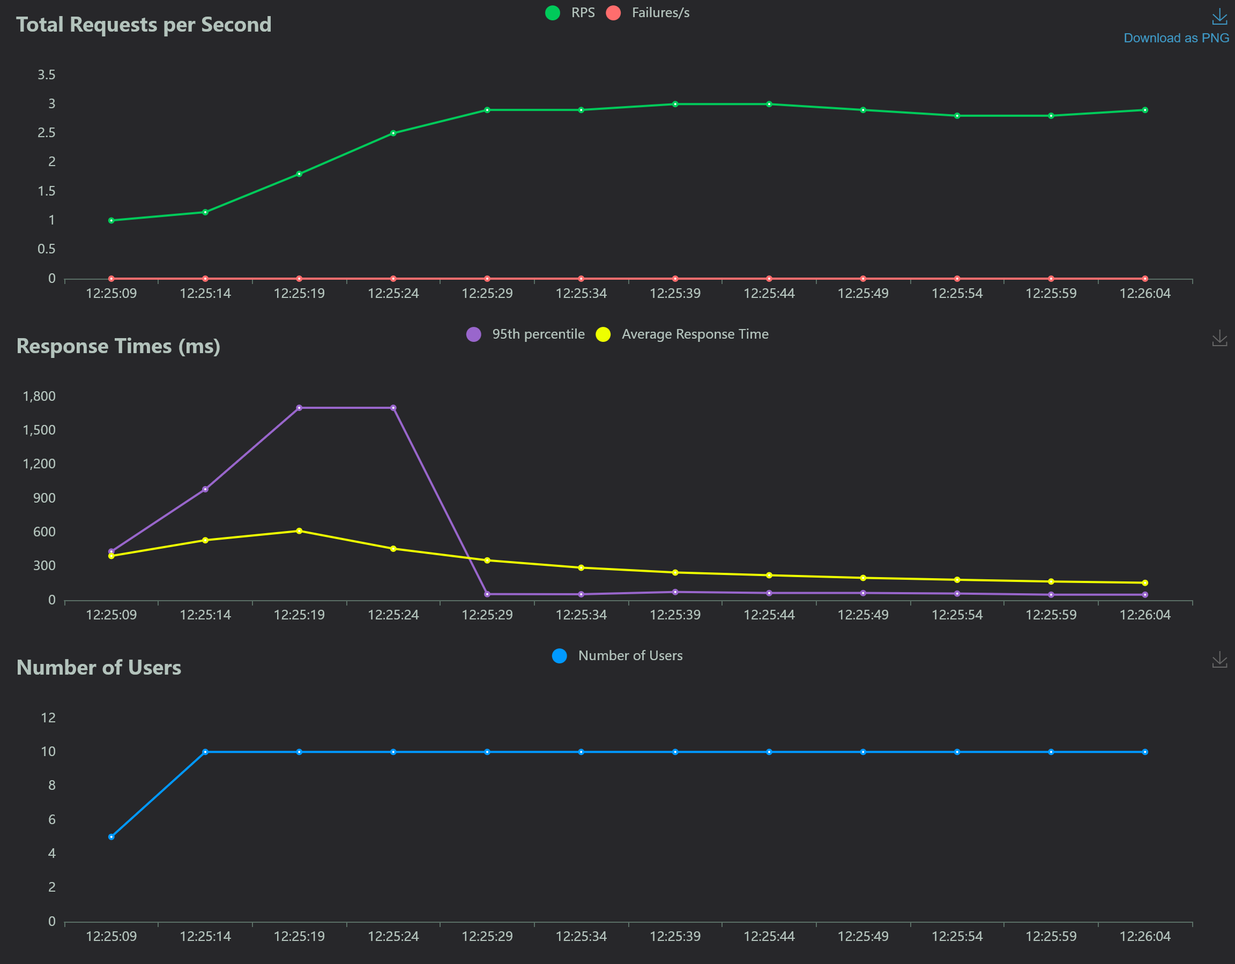
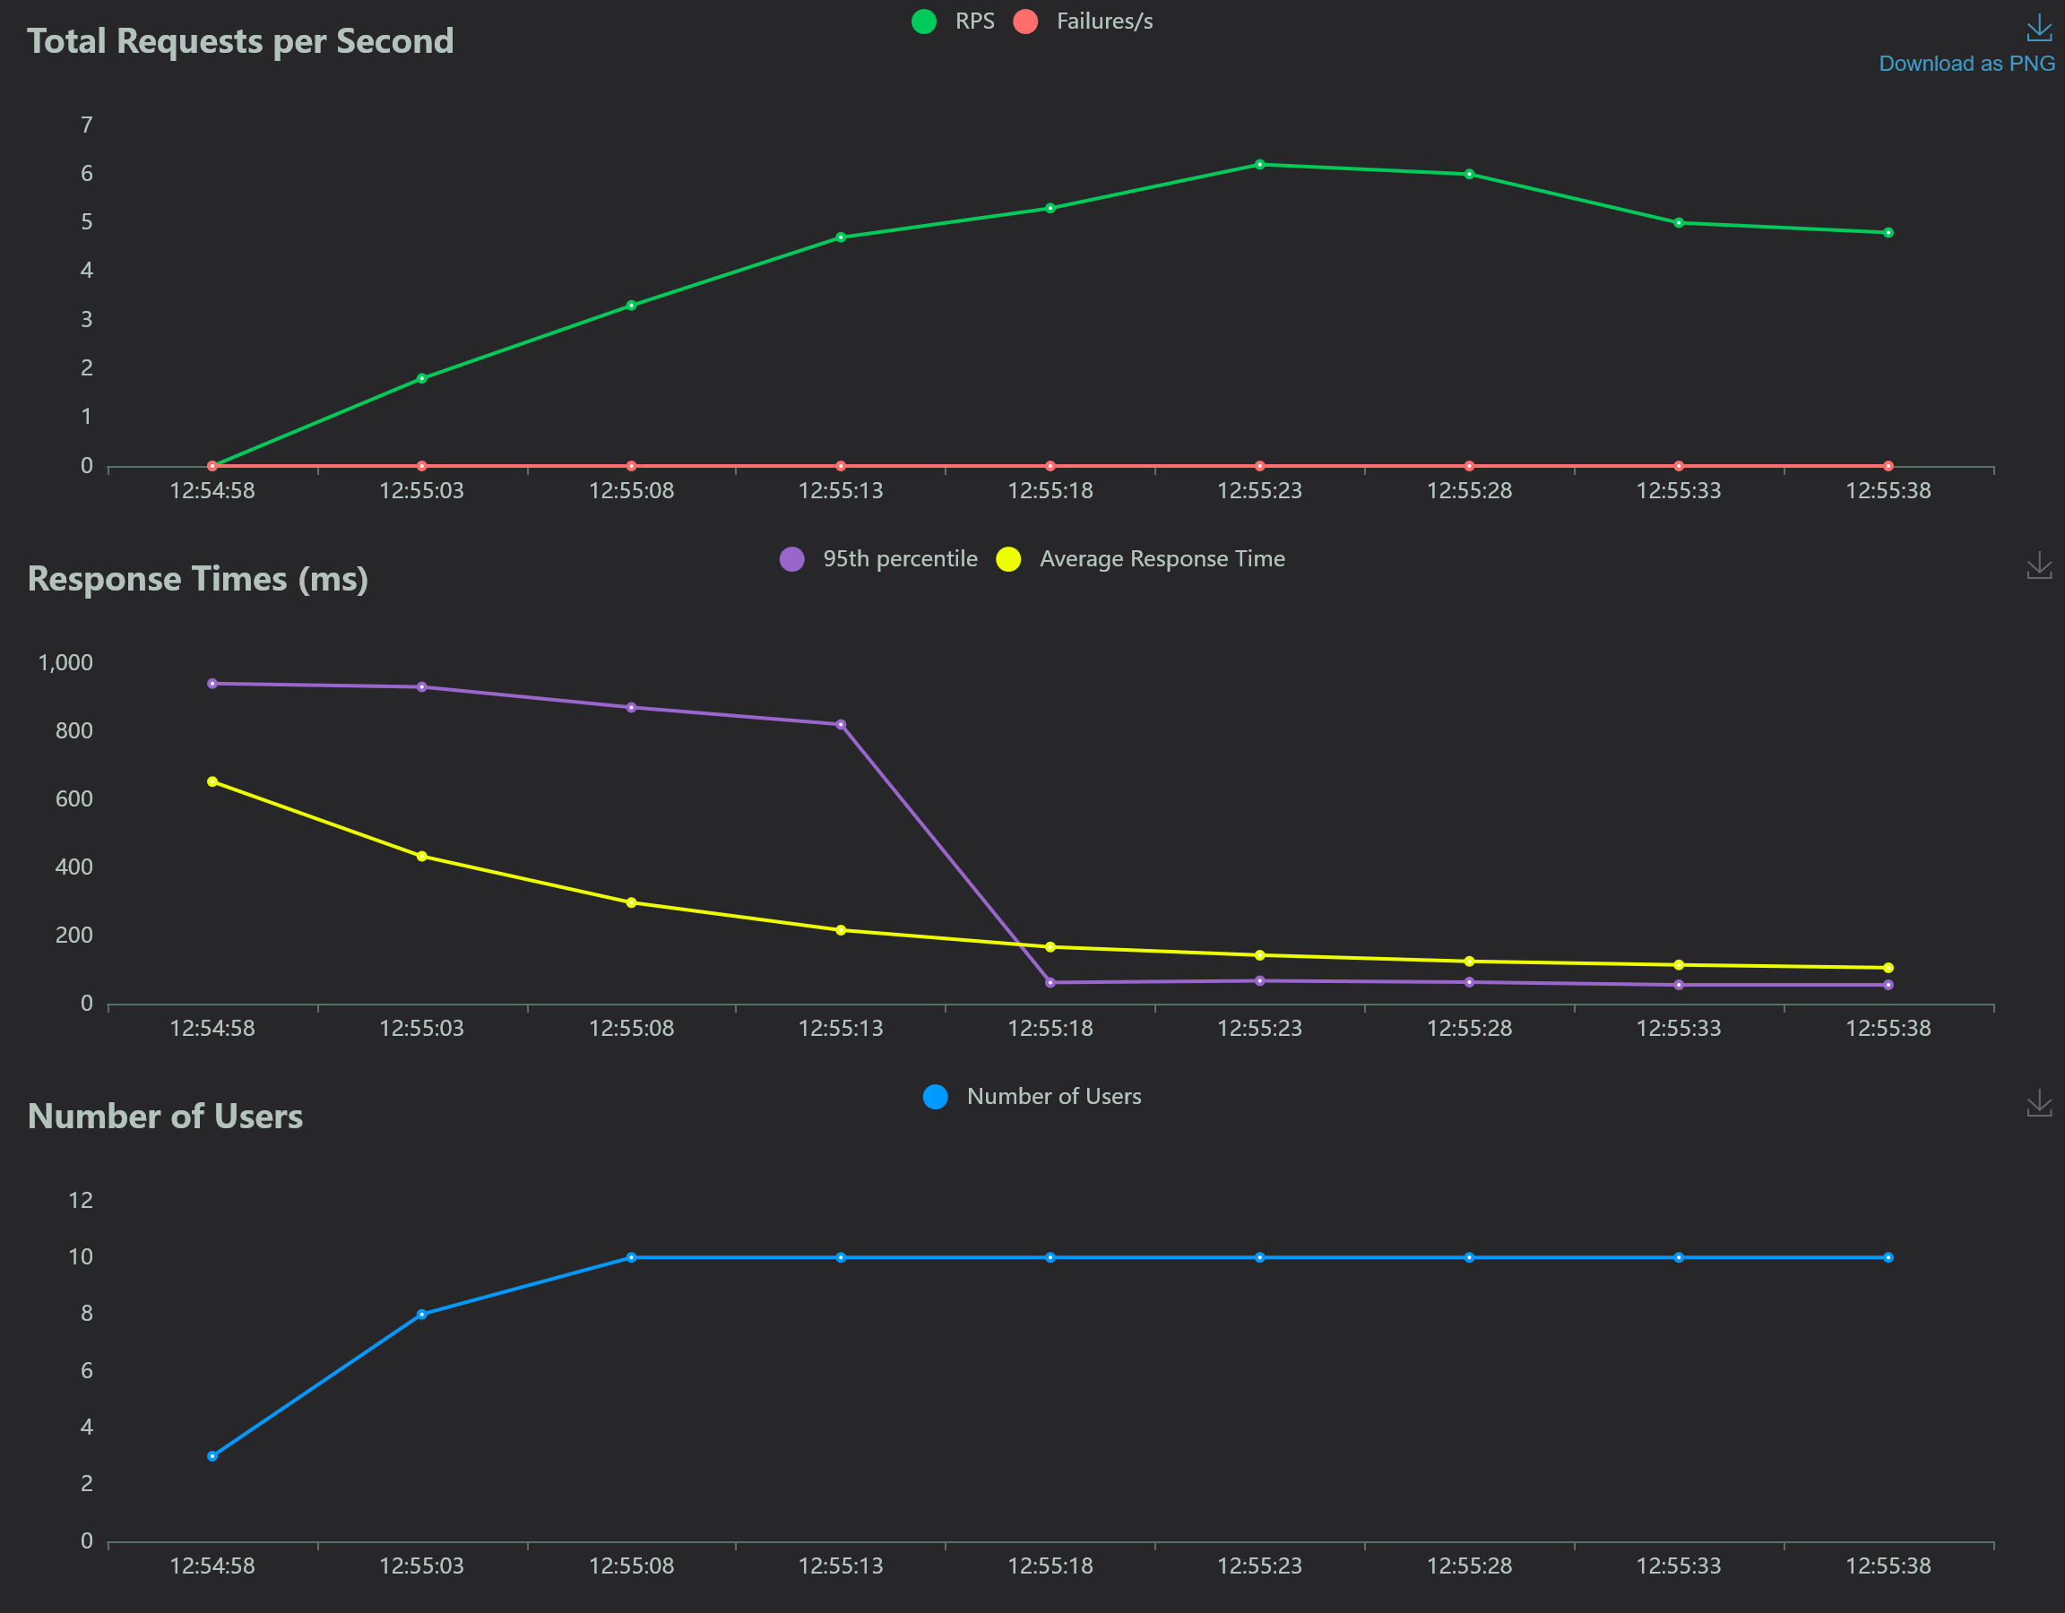
Load-testing results: 500kB - 5MB

Slide 8
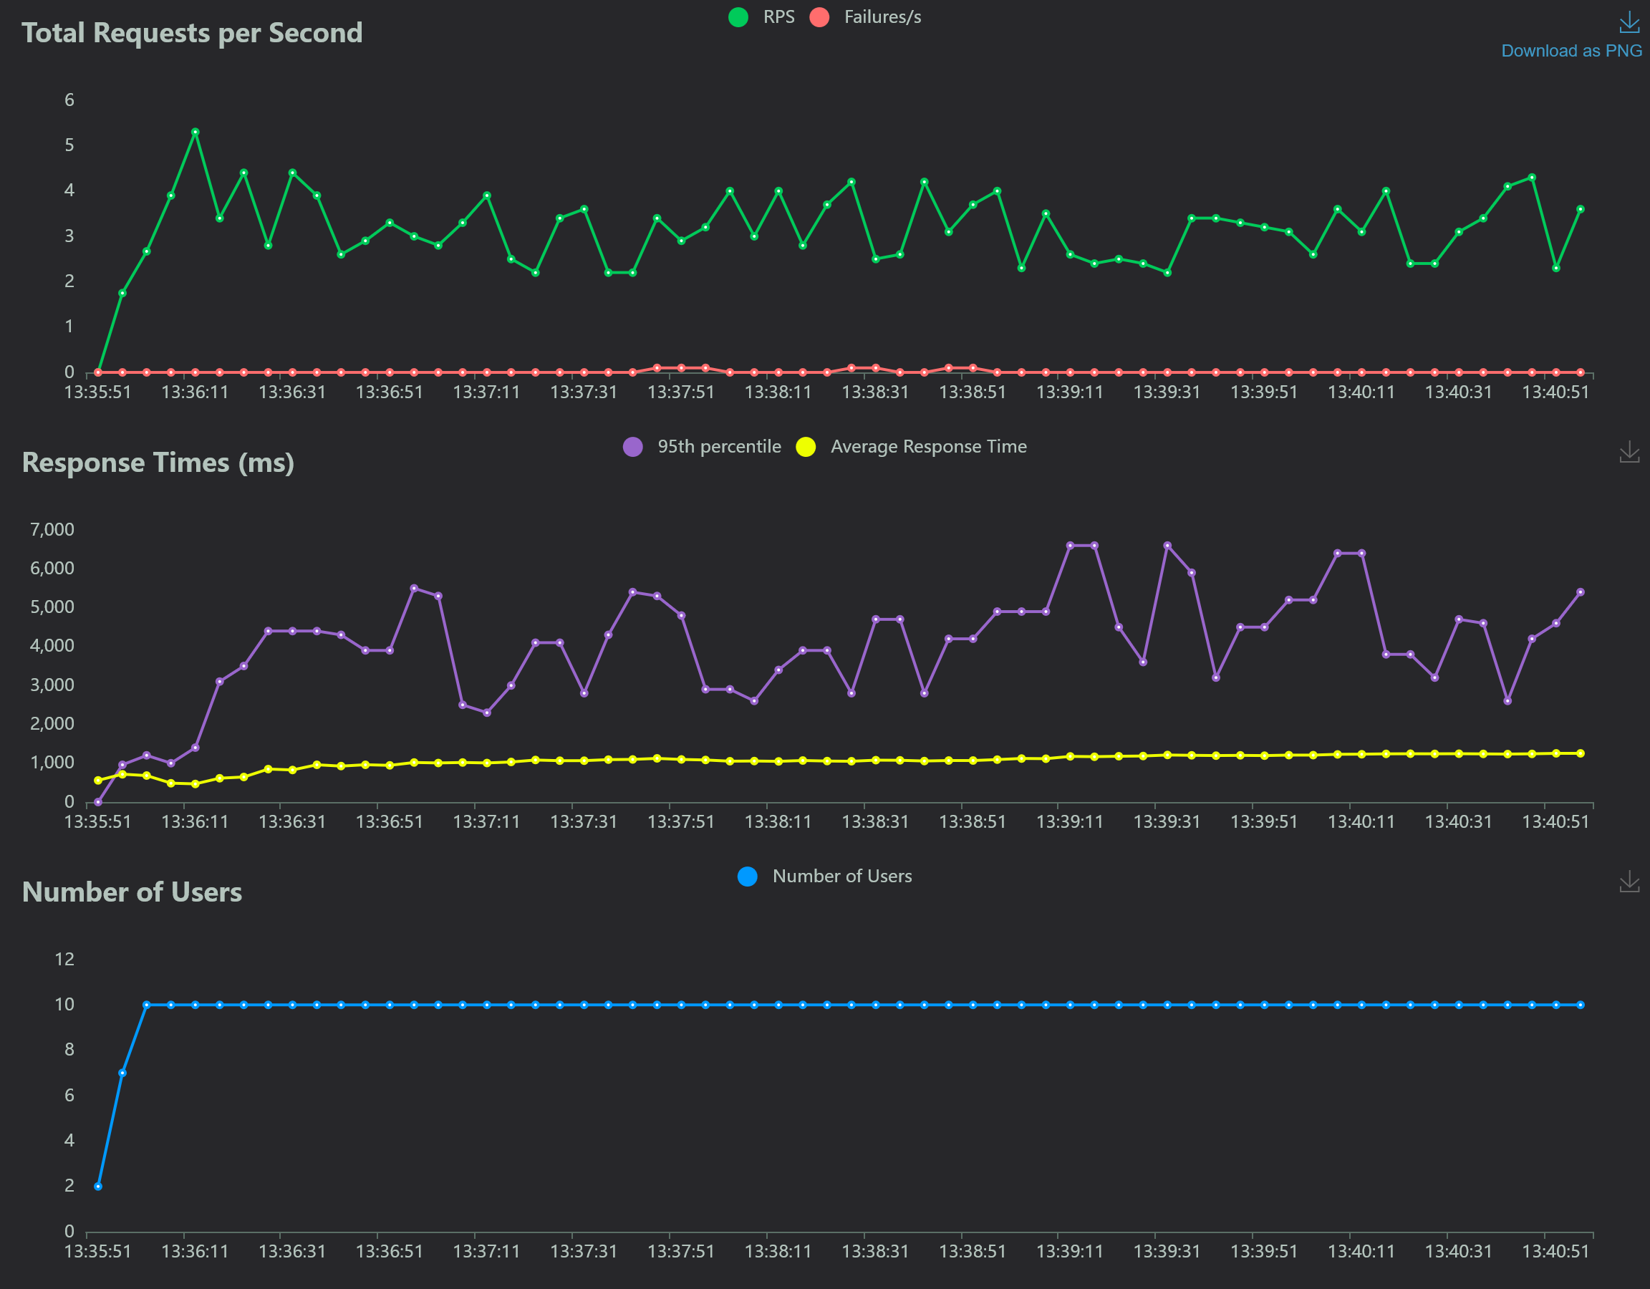
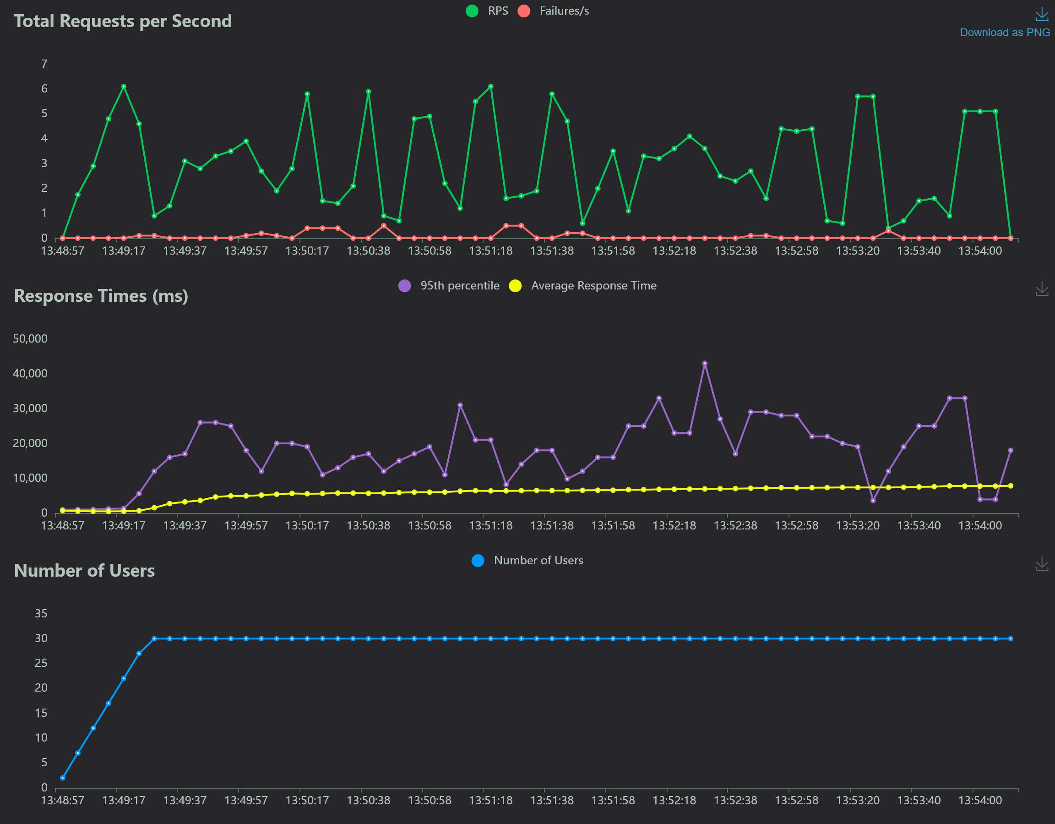
Load-testing results: 50MB

Slide 9
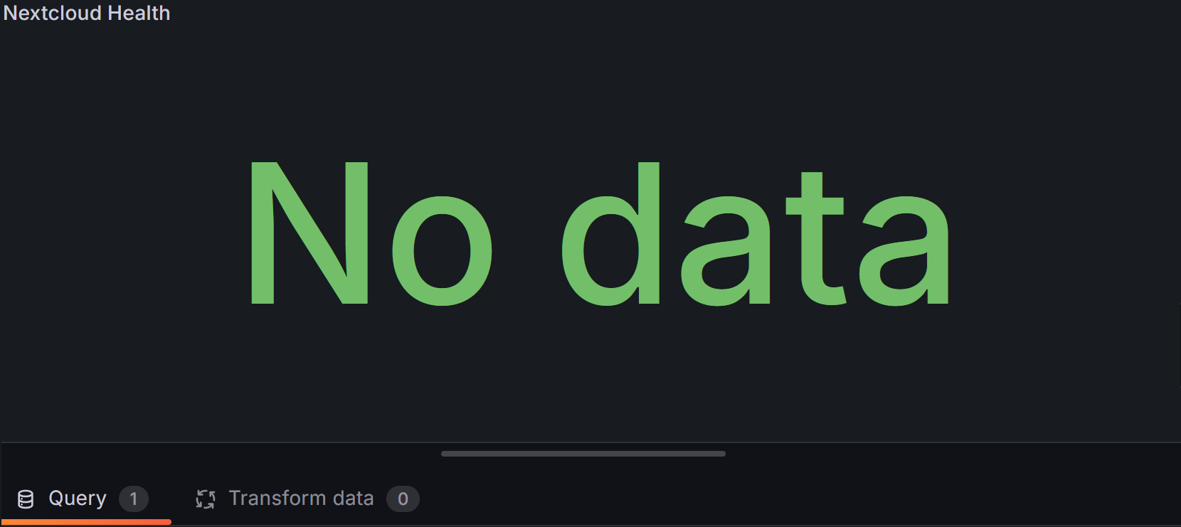
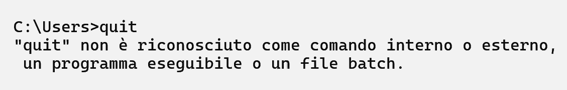
Challenges & Solutions
The Nextcloud Exporter was unable to pull metrics from Nextcloud.
Nextcloud was blocking the exporter because it was scraping too frequently.
This resulted in: nextcloud_up = 0
WSL files from the stress-test almost filled up the disk with thousands of 50MB temporary files
deleting them didn’t help!
The Windows diskpart tool saved the day
Many small issues… but I didn’t give up!

Slide 10

Achievements
✓ Fully containerized Nextcloud deployment
✓ Complete monitoring stack (Prometheus + Grafana)
✓ Automated load testing with Locust
✓ Comprehensive documentation and execution logs

Slide 11
Performance Insights
Small files (50KB) handled efficiently (~15ms response)
System scales well for moderate concurrent load
Authentication is critical for WebDAV operations

Slide 12
scaling and other Improvements
Security: Add TLS/SSL via reverse proxy (Traefik/Nginx)
Scalability: PostgreSQL + Redis backend; horizontal scaling
Cloud Deployment: AWS EC2 + S3 with auto-scaling
Larger Scale Tests: GB-sized files and 100+ concurrent users

Slide 13
Cost-Efficiency
All open-source components (zero licensing)
Lightweight containers optimize resource usage
Cloud deployment would use spot instances for cost optimization

Slide 14

Thank you

Slide 15

Component | Port | Purpose
Nextcloud | 8080 | Main application
Nextcloud Exporter | 9205 | Metrics exposure
Prometheus | 9090 | Time-series database
Locust | 8089 | Load testing
Grafana | 3000 | Visualization dashboard

